Slide 1
NHERI GSC
February General Meeting

Slide 2
Agenda
12:00-12:04 Welcome & Announcements
12:04-12:08 NHERI GSC Election
12:08-12:38 Dr. Ron Schumann
12:38-12:58 Breakout Rooms
12:58-1:00 Wrap up

Slide 3


Welcome New Members
Peter | Ogunjinmi
Wrya | Abdullah
Musawer Ahmad | Saqif
Mariko | Polk
Waqas | Iqbal
Kashif | Salman
Hussam | Mahmoud
Soolmaz | Khoshkalam
Tahereh | Torabi
Adithya | Salil Nair
Beeior Vincent Jasmine Sergio | Labar Davidson Davidson García Mejía
MohammadAli | Izadifar
Vahid Shayan | Shafaie Razi
*Reach out to Faith Nenanya and Sasan Dolati to learn how to get involved!

Slide 4

NHERI Summer Institute
The NHERI Summer Institute is a free event to learn more about the Natural Hazards Engineering Research Infrastructure (NHERI) community. During the three-day Institute participants will meet with NHERI site representatives, K-12 educators, NSF CAREER Awardees, and a program director from the National Science Foundation (NSF). Ten NHERI GSC will be selected to attend. DEADLINE IS FRIDAY, FEBRUARY 24, 2023!
June
21-23
https://bit.ly/2023NHERI_SummerInstitute
Notes:
https://designsafe-ci.zoom.us/meeting/register/tJwufuqqqzIvGtccud5YOr45cD5P181IQnwa

Slide 5
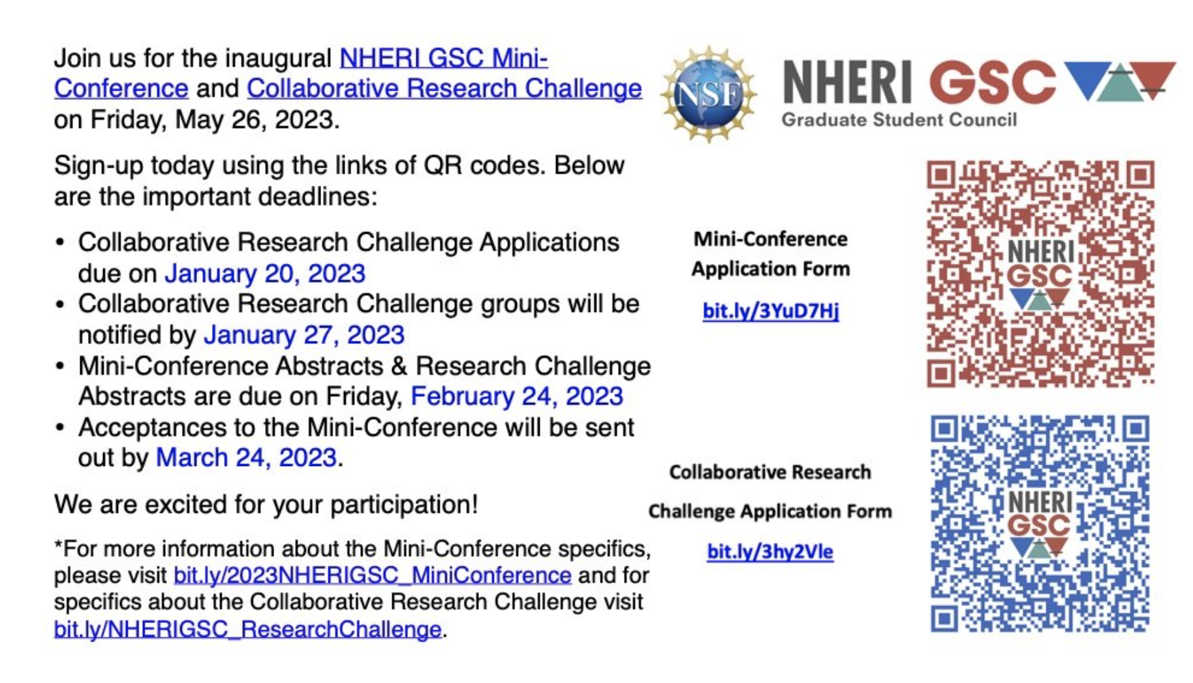
NHERI GSC Mini-Conference
bit.ly/3vNDwaI

Slide 6


2023 Spring Election Nominees
Vice-President
Vice Secretary
Nominate Today

Slide 7
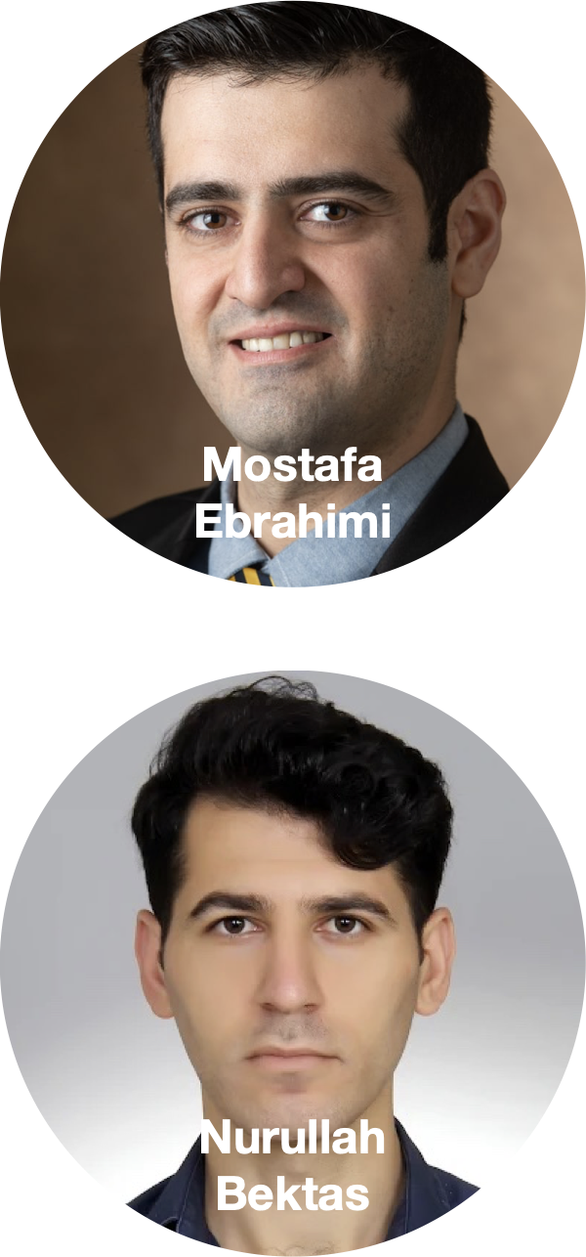
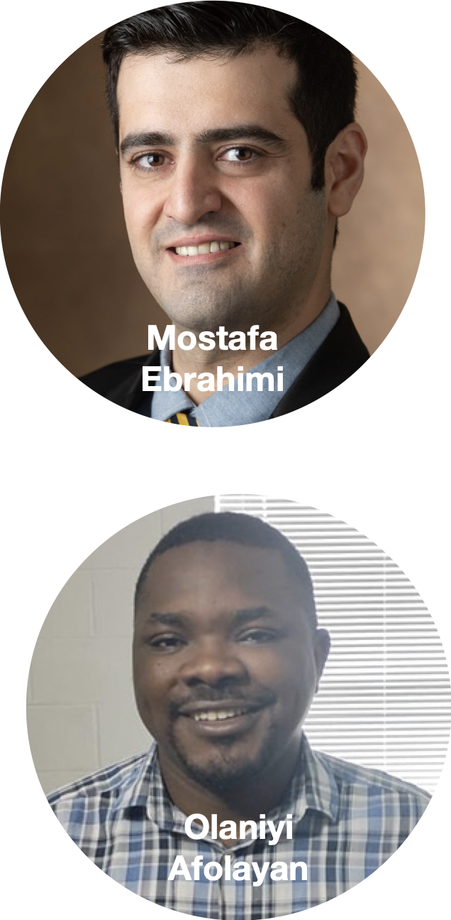
2023 Spring Election Nominees
Vice-Treasurer
Vice-Chair of Workshop & Mentoring

Slide 8
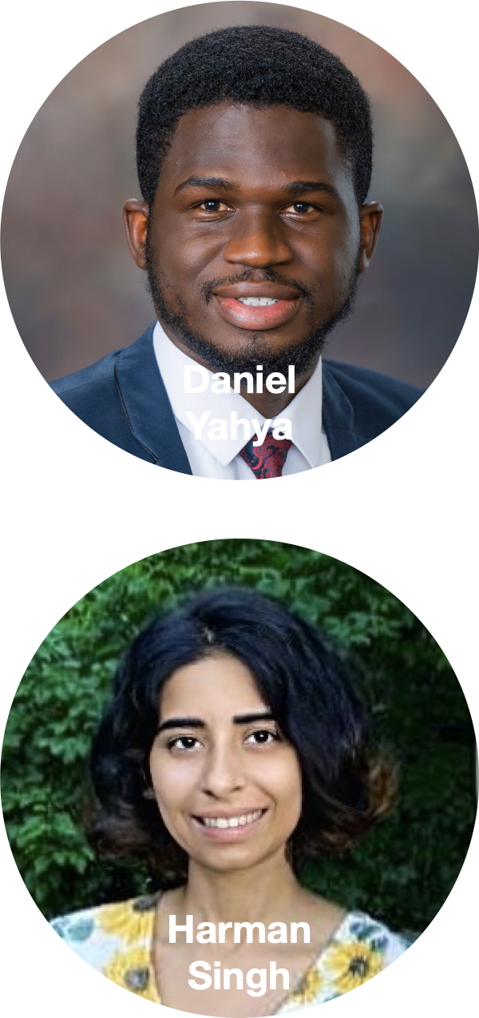
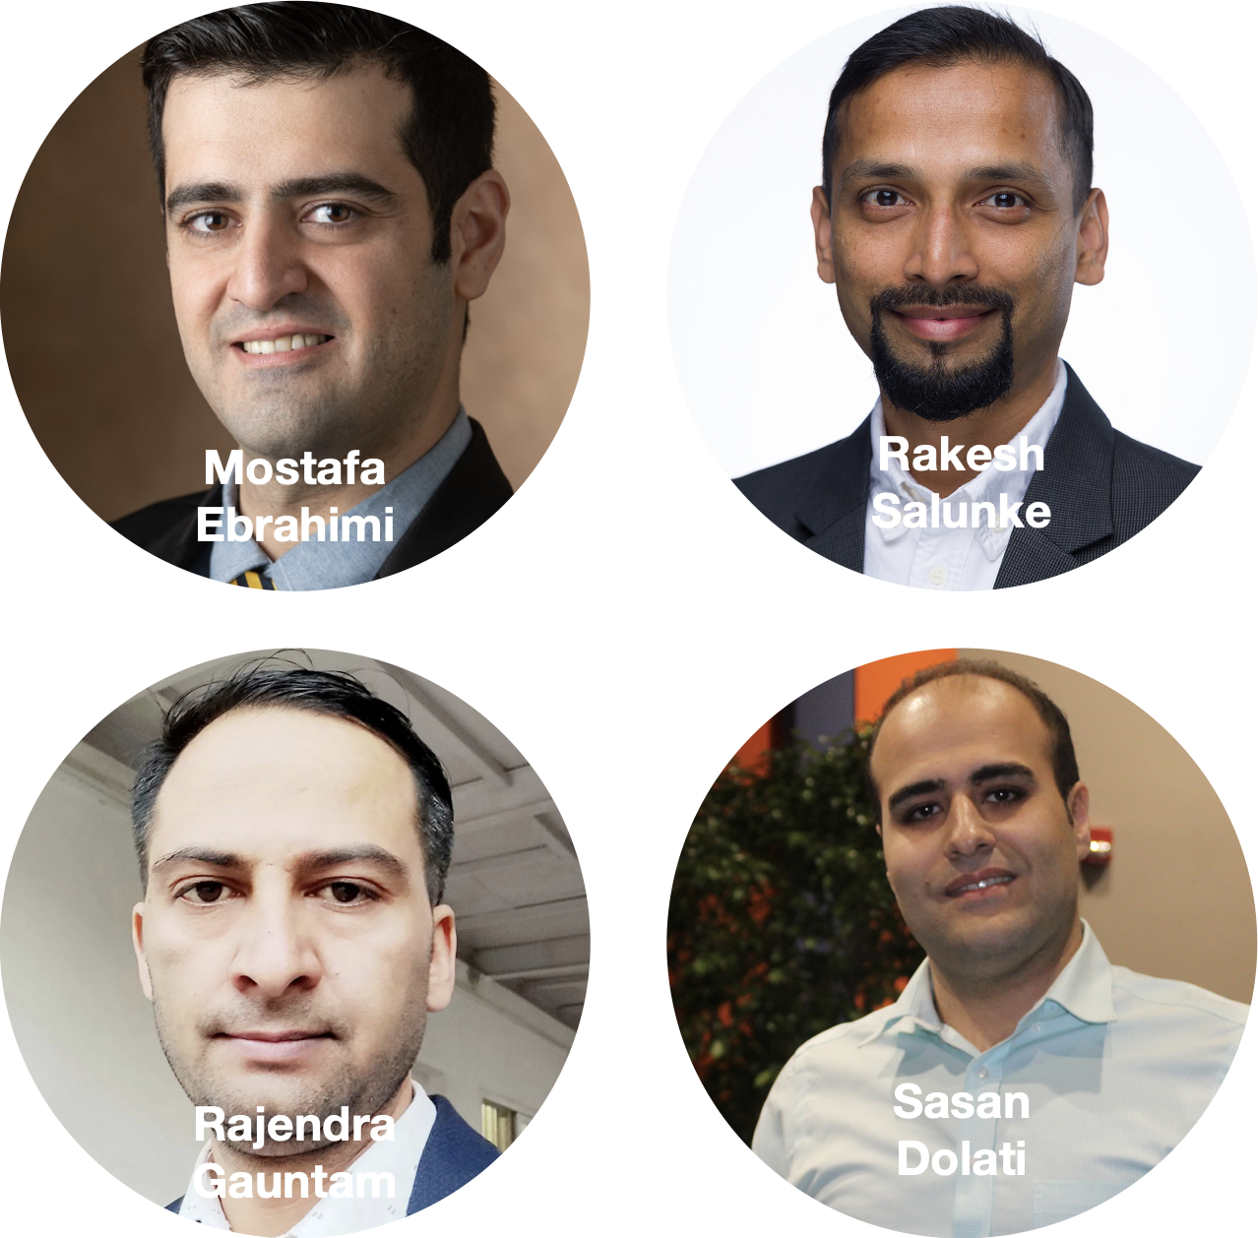
2023 Spring Election Nominees
Vice-Chair of DEI
Vice-Chair of Research

Slide 9

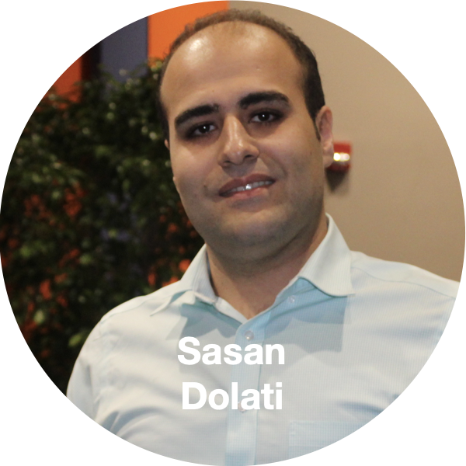
2023 Spring Election Nominees
Vice-Chair of Networking & Community Building
Vice-Chair of Membership

Slide 10
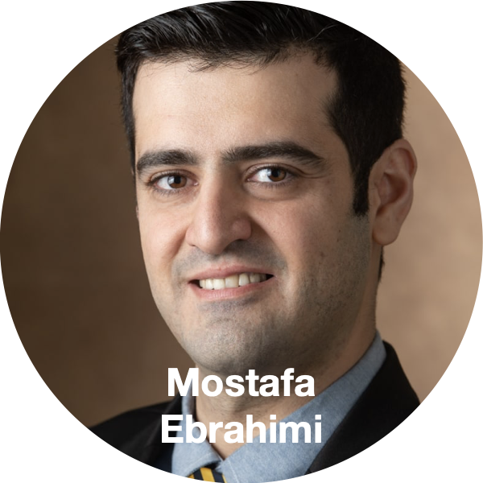
2023 Spring Election Nominees
Vice-Chair of Technology & Communication
Election will be held on Friday, February 17 via an emailed Qualtrics Link

Slide 11
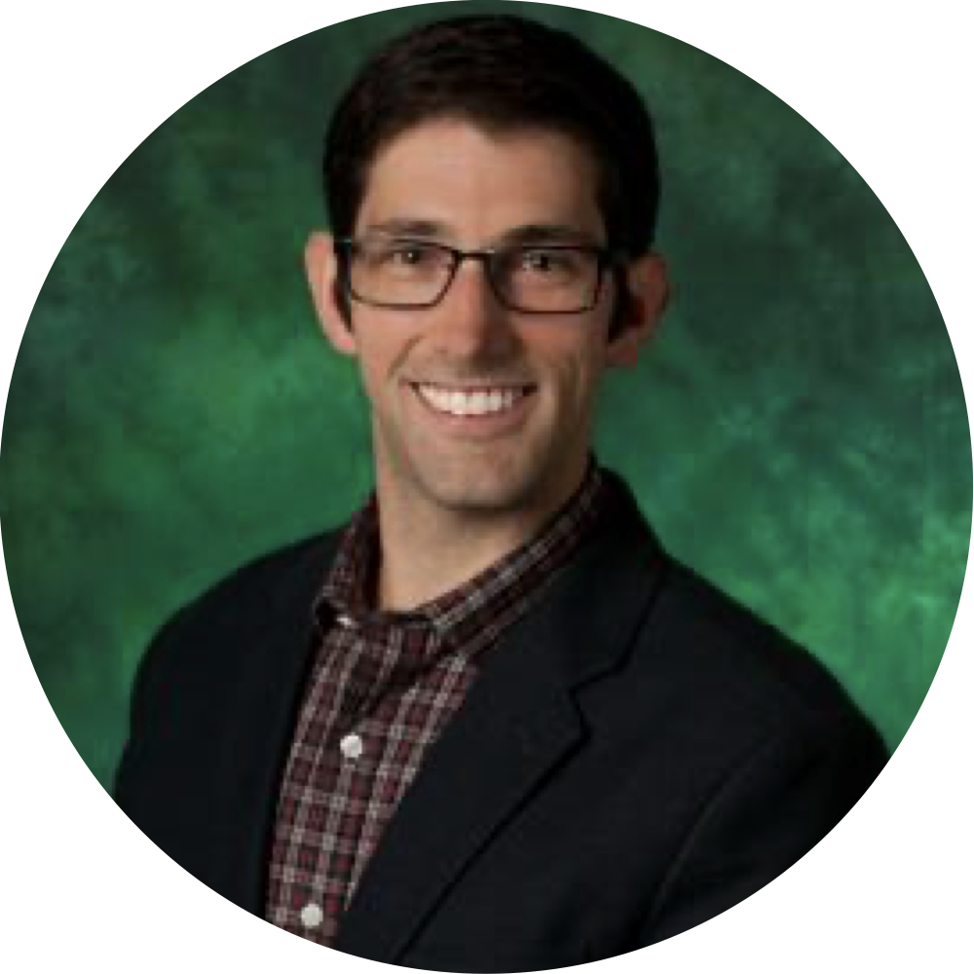
Speaker Introduction
Dr. Ron Schumann
Associate Professor Department of Emergency Management and Disaster Science
Ronald.Schumann@unt.edu
Notes:
Ronnie Schumann is an assistant professor at UNT in the department of Emergency Management and Disaster Science, where he uses his background as a human geographer to explore social vulnerabilities in disasters using quantitative and qualitative methods and community engagement to quantify disaster issues and help build community recovery and resilience in impacted groups. His latest work, "From the Ashes: A study of mitigation policy and practice after wildfire in California" supported through the Natural Hazards Center, FEMA, and NSF "Mitigation Matters Research Program" moves the discipline forward in the area of wildfires, which became even more important in 2022 where over 360,000 acres burned in California.
A fierce supporter of NHERI GSC, Ronnie helped support the first NHERI GSC joint presentation at the 2022 Disaster PRIMR Conference in Denton, and students fortunate enough to take classes from him have spoken about his ability to make the most complex disaster concepts comprehensible for all. Please help me welcome Ronnie to our February NHERI GSC meeting.

Slide 12
Presentation
Access Ronnie Schumann’s recorded presentation on YouTube (https://www.youtube.com/watch?v=eIWpm7b481s).

Slide 13

Future Meeting Dates
*Join us for the NHERI GSC DEI CONVERGE Modules Workshop on Friday, February 24!
3rd Friday of every month at 11:00am
CST
March
17

